Slide 1

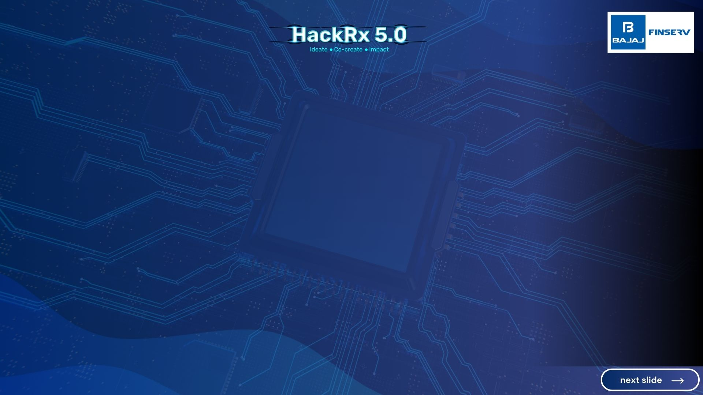







HAPPY YADAV
HISHITA GUPTA
Chitkara University
Chitkara University
BCA - 2026
BCA - 2026
💻
Backend Dev And Data Specialist
💻
Lead Frontend Dev & UI/UX Designer
FinTrack - A finance management web application for tracking and managing income, expenses, and transactions.
News Mania - A web app fetches top business news headlines via NEWSAPI and integrates Google auth. and GitHub user data.
Student Portal System- A web-based application developed in ReactJS to manage student data, test scores, and progress.
JBL Website – Recreation of the JBL website with modern UI/UX and interactive user-friendly functionalities.
Invited at GHFD’24 @Microsoft
Vihaan 7.0 Social Buzz Award Winner
CBSE City Topper 2023
Top 300 in GirlScript Summer of Code 2024.
Vihaan 7.0: Gained experience in the field of AI integration and built good connections with the teams working in the same domain.
Vihaan 7.0: Had an enriching experience collaborating with like minded students to make technical solutions to solve real world challenges.
Personal Info
Projects
Awards/ Accolades
Hackathons

Slide 2
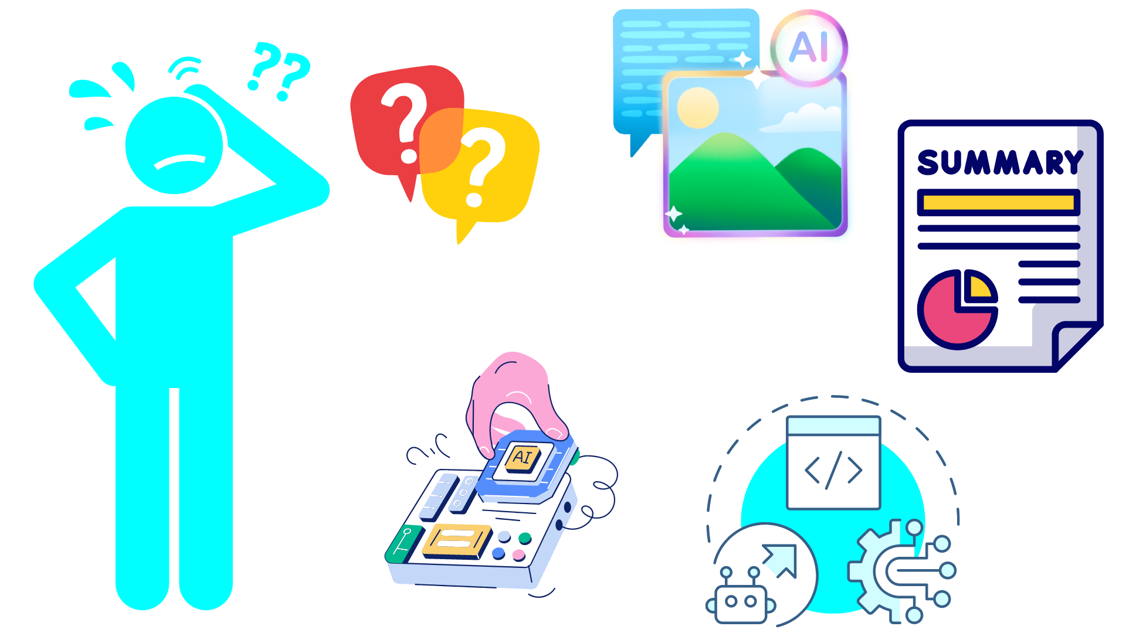
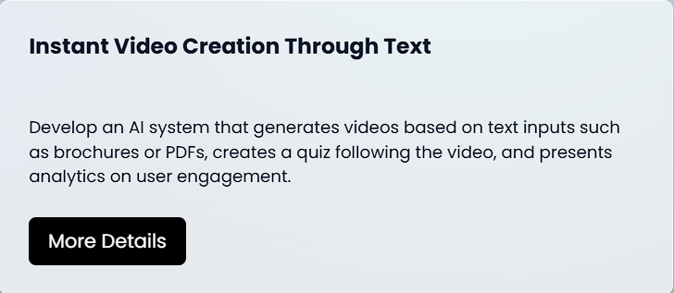
Instant Video Creation Through Text
Develop an AI system that generates videos based on text inputs such as brochures or PDFs, creates a quiz following the video, and presents analytics on user engagement.
Use Slideshow for better experience.

Slide 3

PRESENTING TO YOU
AURA.ai
From words to videos, with interactive quizzes and powerful insights.

Slide 4
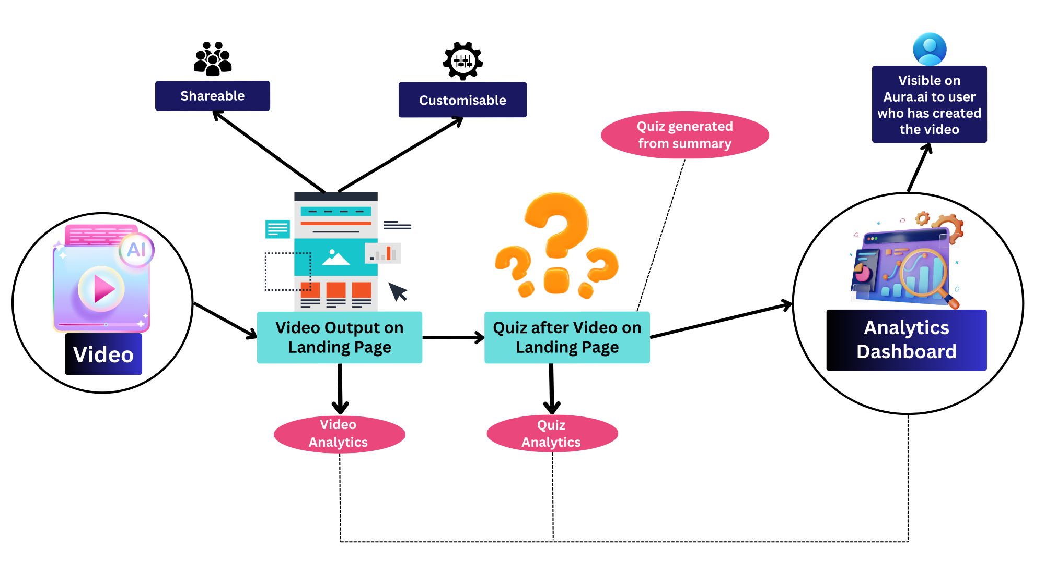
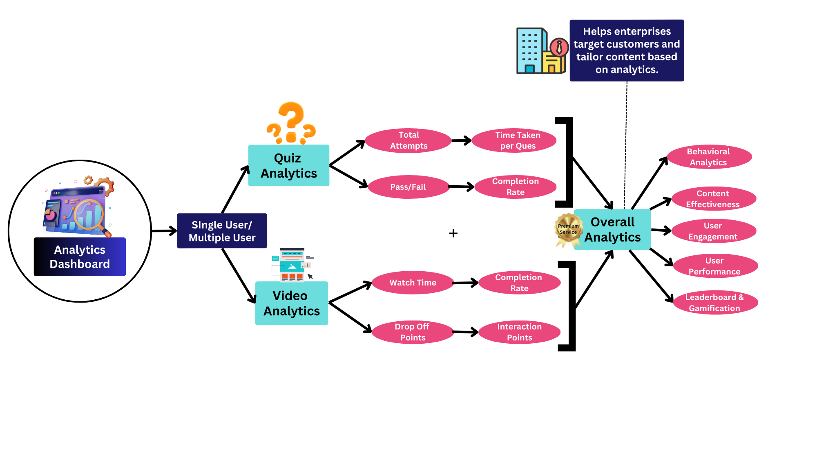
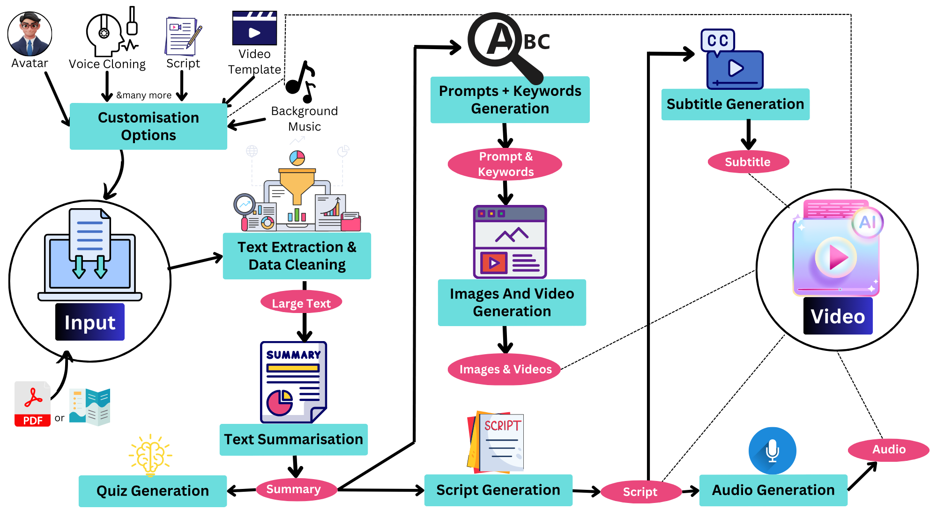

Stage I
TEXT TO VIDEO CREATION
Click here to view
AURA.ai
Stage II
VIDEO PAGE WITH QUIZ
Process Flow
Click here to view
Stage III
ANALYTICS DASHBBOARD
Click here to view

Slide 5
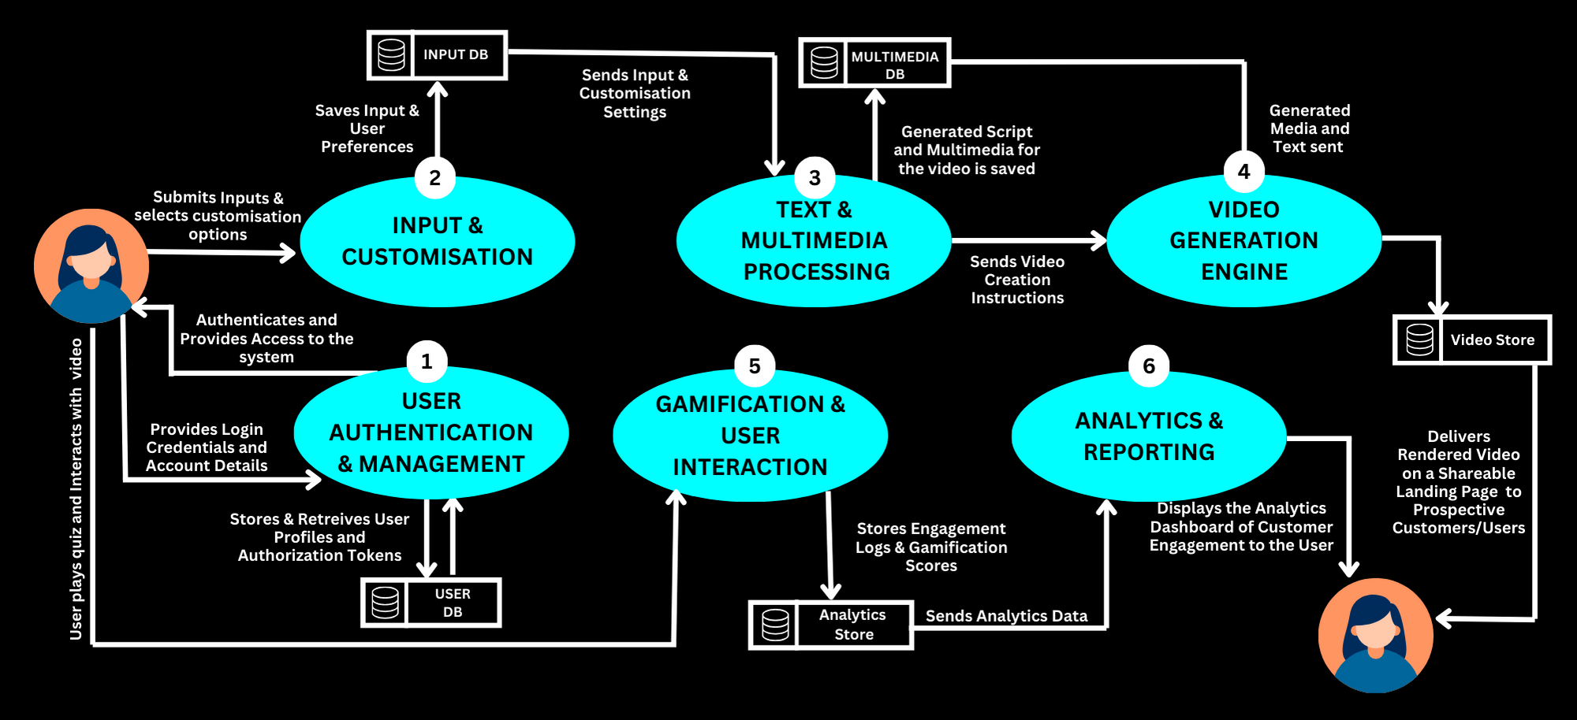

Data Flow
UNIQUE
SELLING
POINT

Slide 6












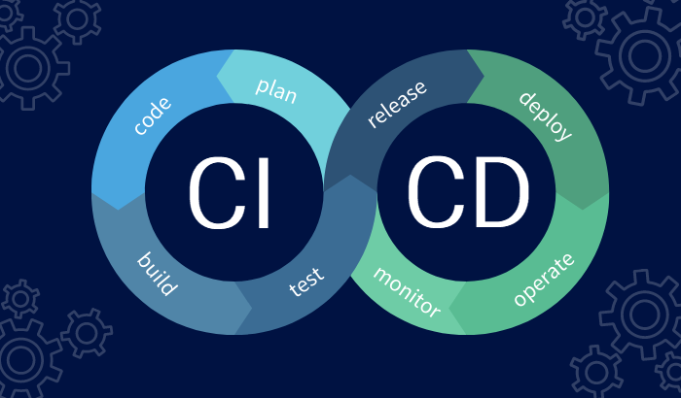
TECH STACK
Frontend
NLP & ML
Industrial Add-Ons
React.js
Recharts
Tailwind CSS
BART
Stable Diffusion
Tesseract OCR
Gemini 1.5 Flash
TensorFlow
PyTorch
wav2lip
Husky (for code quality)
Clarity (for error recording)
Sentry (for error detection)
PlayWright (for testing)
Cloud Service
Provider
Design
Backend
Figma
Canva
Befunky
Python
FastAPI
Node.js
Express.js
Firebase
Digital Ocean
Tools
Others
Hosting
Postman
Git/Github
Google Colab
Kaggle
CI/CD Pipelines
Pexels
Transformers
pdfplumber
Pydub
moviepy
Vercel
Railway
Notes:
Frontend:React.js Recharts Tailwind CSS
Backend: Python FastAPI Node.jsExpress.js
Cloud Service Provider:FirebaseDigitalOcean
Hosting: VercelRailway
Industrial Add Ons:Husky (for code quality)Clarity (for error recording)Sentry (for error detection)Playwright (for testing)
NLP & ML:BART, Stable Diffusion, Tesseract OCR, Gemini 1.5 Flash, TensorFlow,PyTorch
Design: Figma, Canva
Tools: Postman, Git/GitHub
Others:Kaggle, CI/CD Pipelines, Pexels, Transformers, pdfplumber, pydub, moviepy

Slide 7

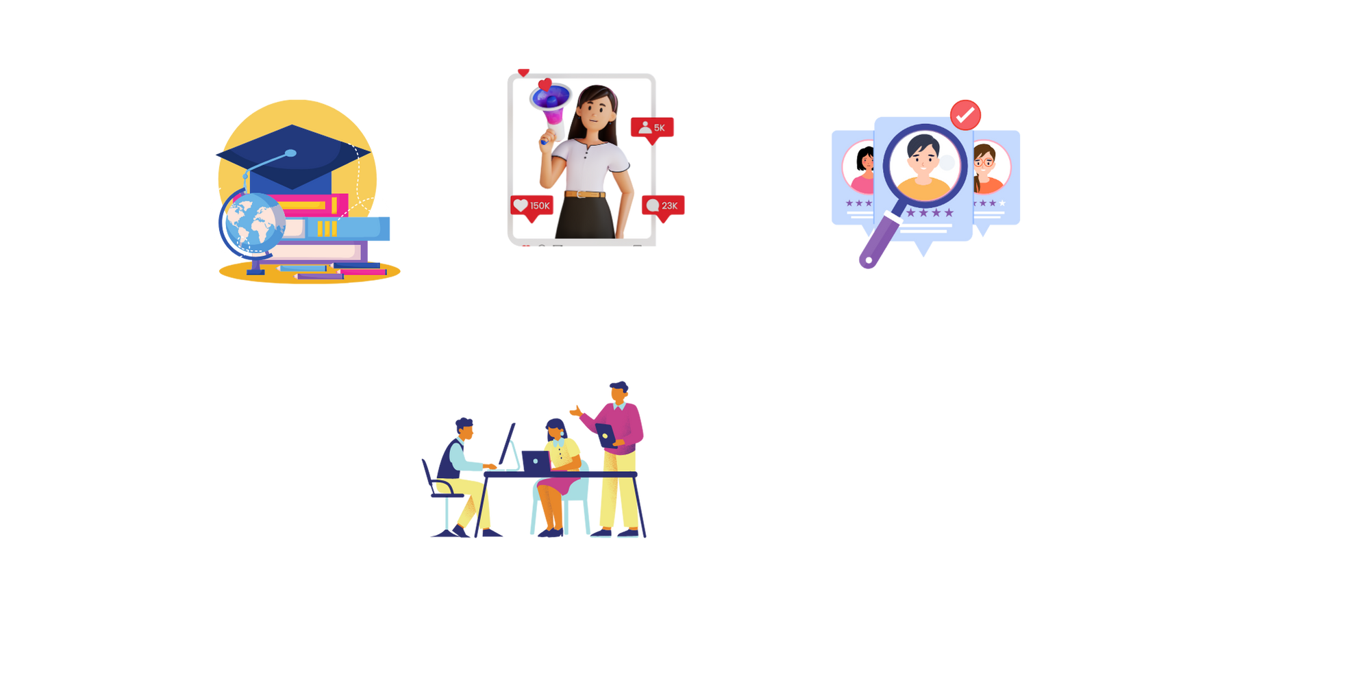



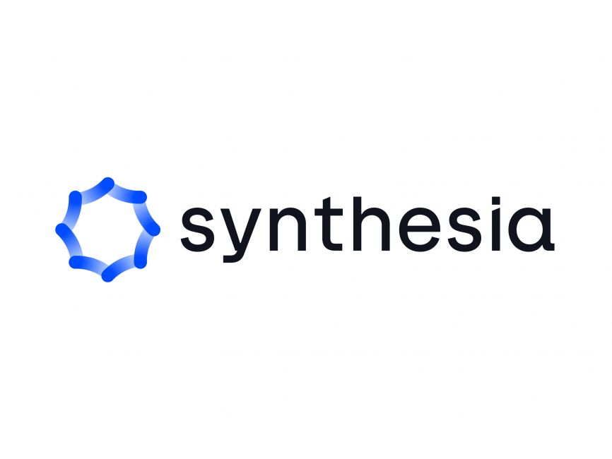
TARGET SECTORS
COMPETITIVE LANDSCAPE
High Scalability
Marketing &
Social Media
Corporate Training &
E-learning
Few Engagement Features
Advance Engagement Features
Education and EdTech
HR & Recruitment
Low Scalability

Slide 8
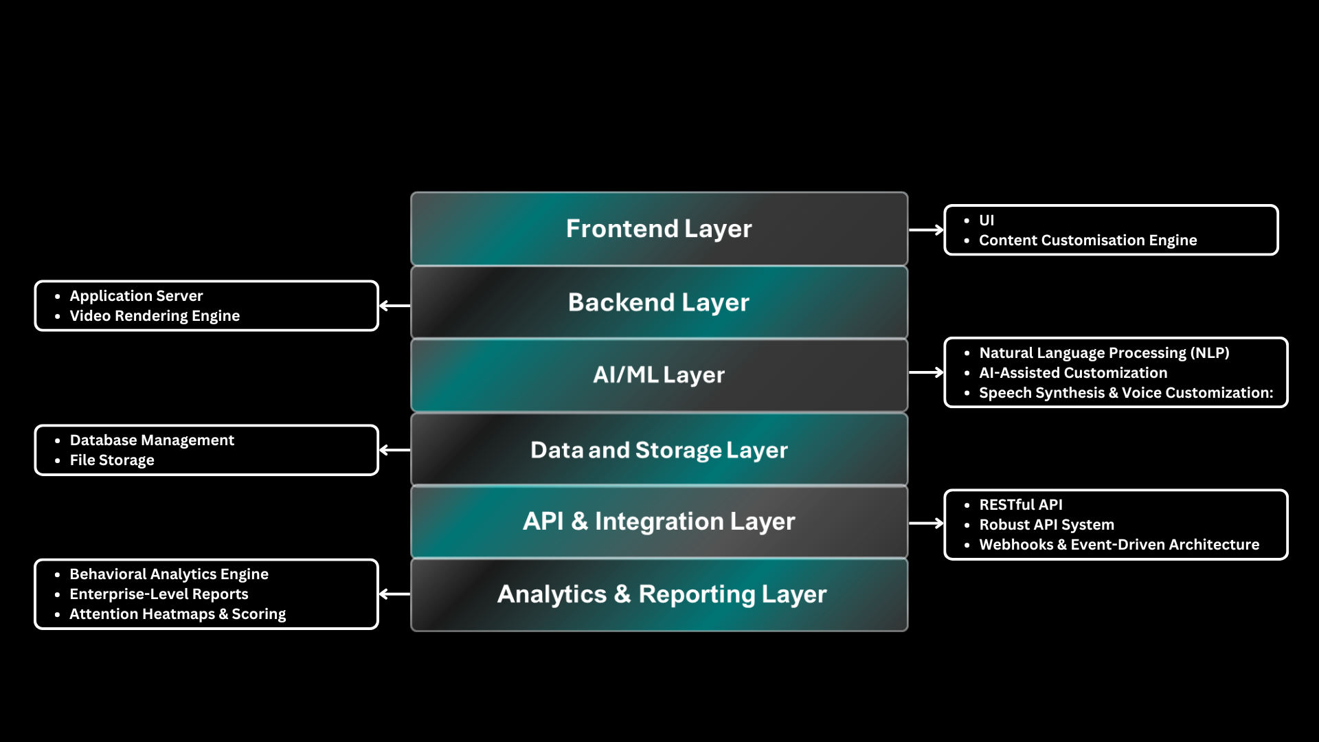
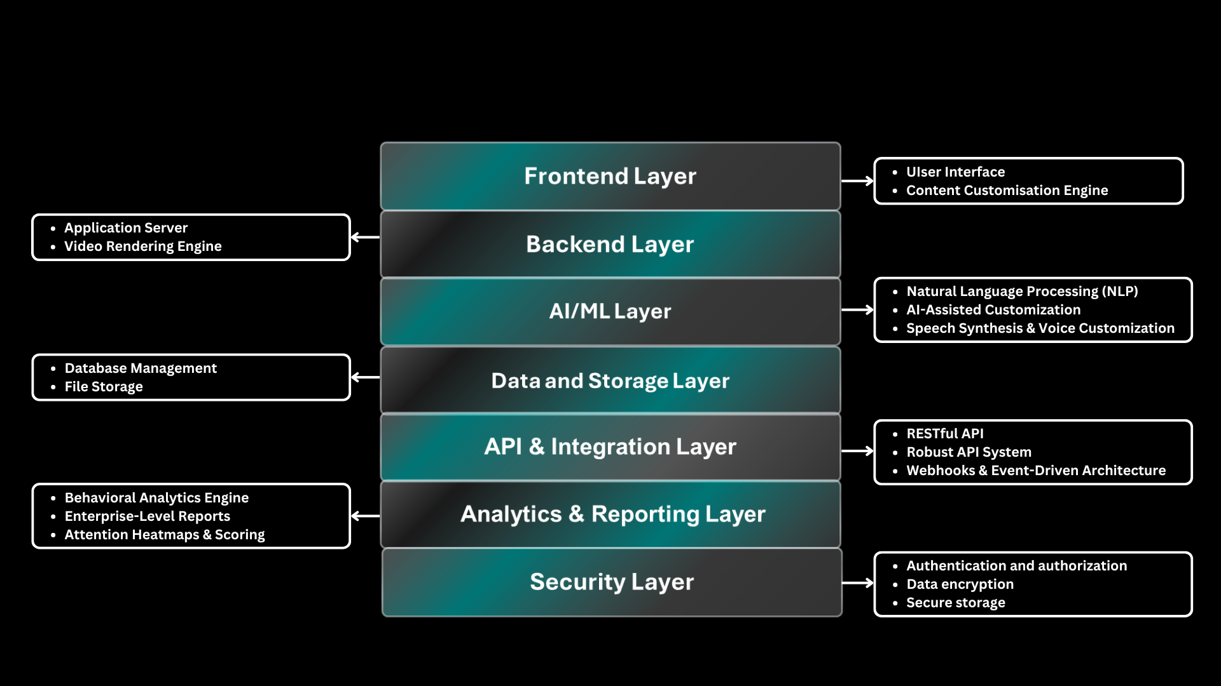
ARCHITECTURE
Security Layer
Backend Layer
AI/ML Layer
Security Layer
Data and Storage Layer
API & Integration Layer

Slide 9

Enterprise Level Analytics
Leaderboards, gamification, and point system with badges.
Insights on employee comprehension and HR team dynamics.
Multilingual
Support
Adaptive video content in 10+ languages.
Enhanced global engagement and personalized learning.
Why AURA.ai
By
Bajaj Finserv
Seamless Integration
Videos can be embedded, downloaded, or shared via link.
Easy access and wide distribution.
Voice-Activated Navigation
Hands-free platform controls.
Accessibility for users with disabilities.
Team Collaboration Tools
Streamlined collaboration for teams.
Ideal for corporate training and education.

Slide 10
PRICING PLANS
Basic (Free)
Premium
Enterprise
Features
Features
Features
Unlimited text-to-video creation
Watermark free videos
Multilingual support (unlimited)
Advanced video templates
Customizable video branding
Advanced analytics (AI powered Insights , behavioral analytics, user performance etc.)
AI-generated human avatars for lifelike explanations
Robust API integrations
Priority email support
White-label solutions
CRM integrations (e.g., Bajaj Finserv)
Limited text-to-video creation (e.g., 3 videos/month)
Single language support
Basic video templates
Basic analytics (total views, average watch time)
Access to a community forum for support
Watermark free videos
Multilingual support
Advanced Video Templates
Advanced Analytics
AI generated Avatars
White Label Solutions
CRM integrations
Unlimited text-to-video creation
Watermark free videos
Multilingual support
Access to advanced video templates
Customizable video branding
Advanced analytics dashboard Post-video quiz with analytics
Basic AI-generated avatars for more lifelike explanations
Robust API integrations
Priority email support
White Label Solutions
CRM integrations

Slide 11
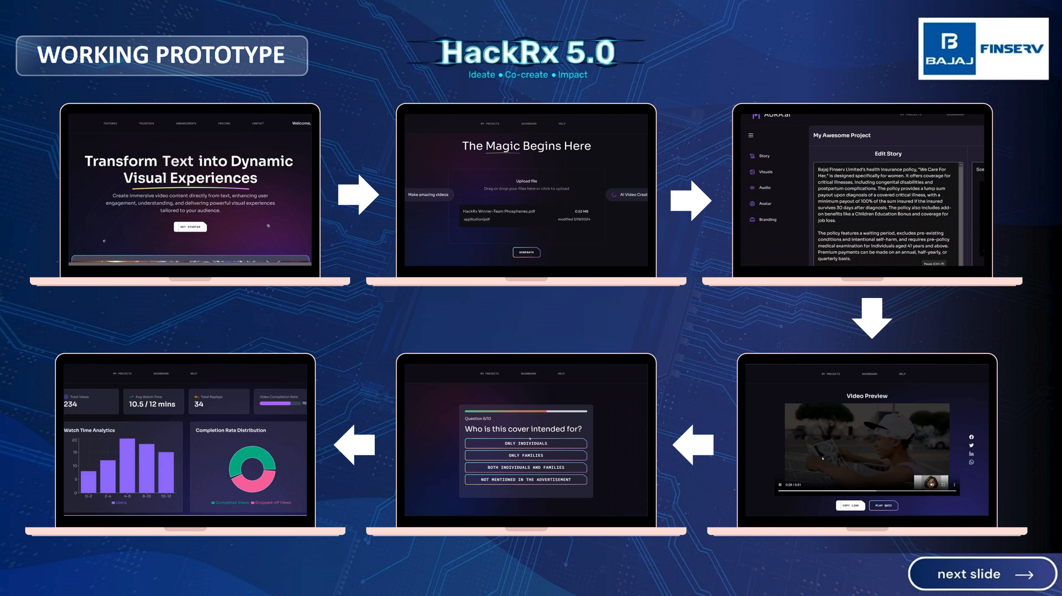

Slide 12


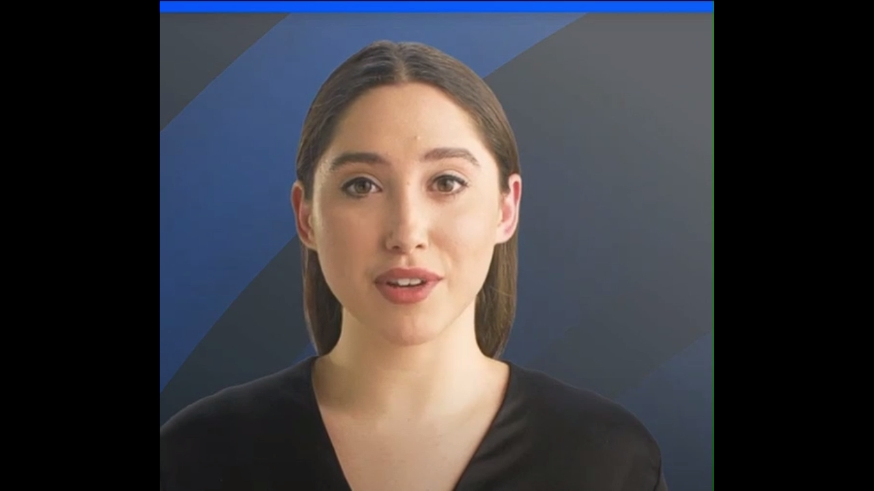

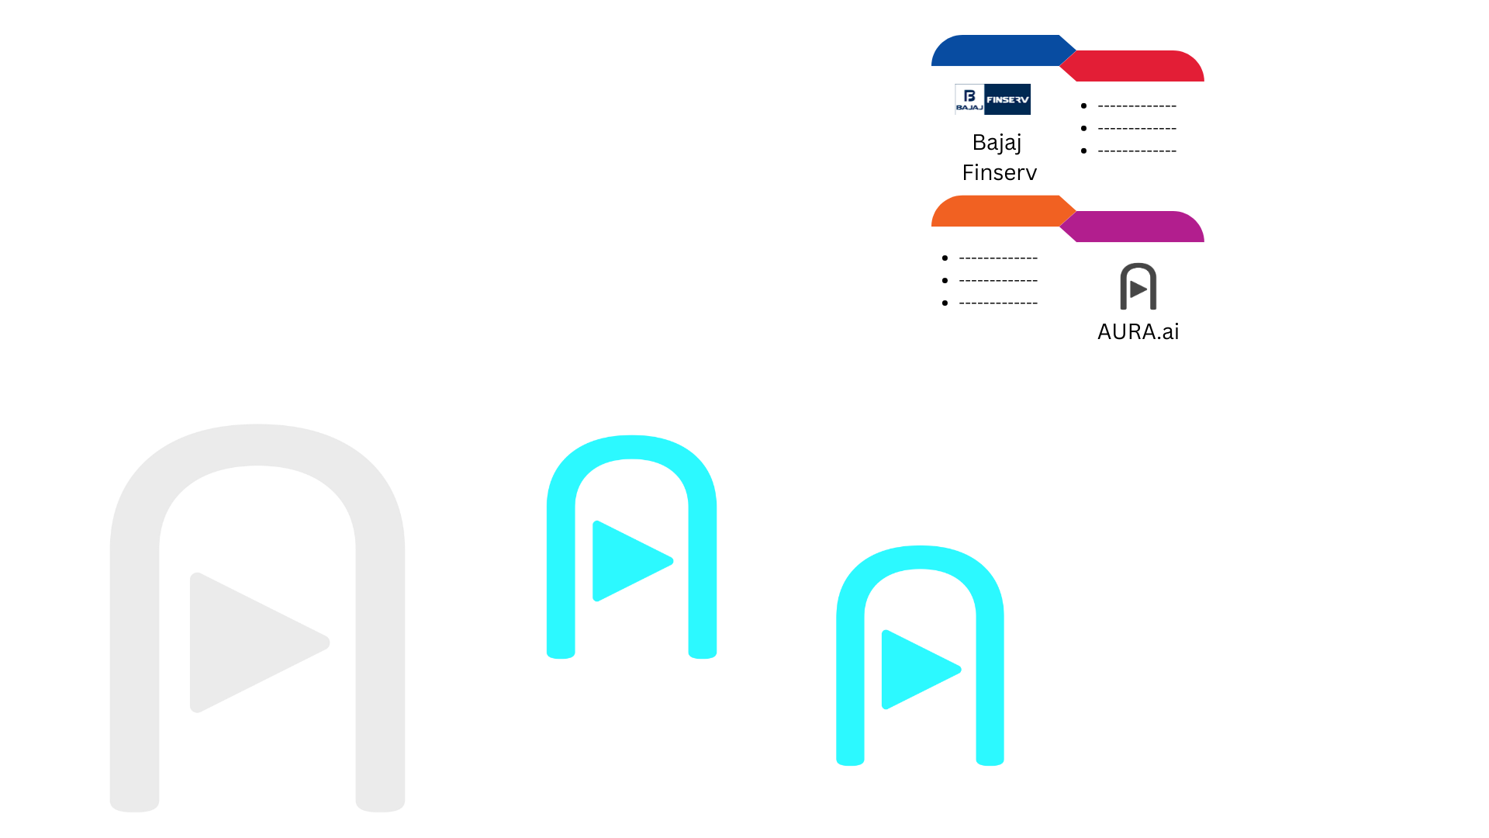

FUTURE ENHANCEMENTS
Click to Play
Realistic AI Avatar Integration
Virtual Reality Support
AI Interview Taker &
Candidate Analytics
Incorporation of Flash Cards
Lifelike speech and facial expressions
Adds a human-like touch to video explanations
Immersive video experiences
Boosts engagement and comprehension
Dynamic AI-driven interviews
Performance analytics for HR teams
Interactive cards with key highlights
Infographics for better understanding
Notes:
Realistic facial expressions
Lifelike speech, and dynamic gestures
Human-like touch to video explanations
Vr
Users can experience the video content in an immersive environment
Enhancing engagement and understanding
AI Interview Taker & Candidate Analytics

Slide 13
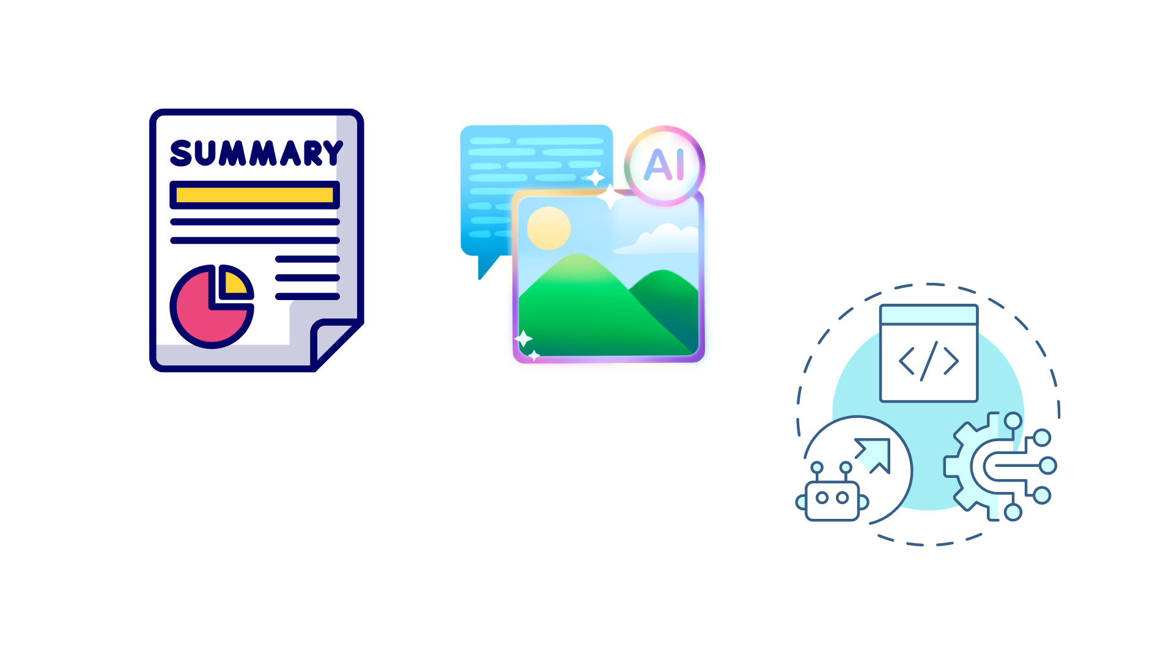
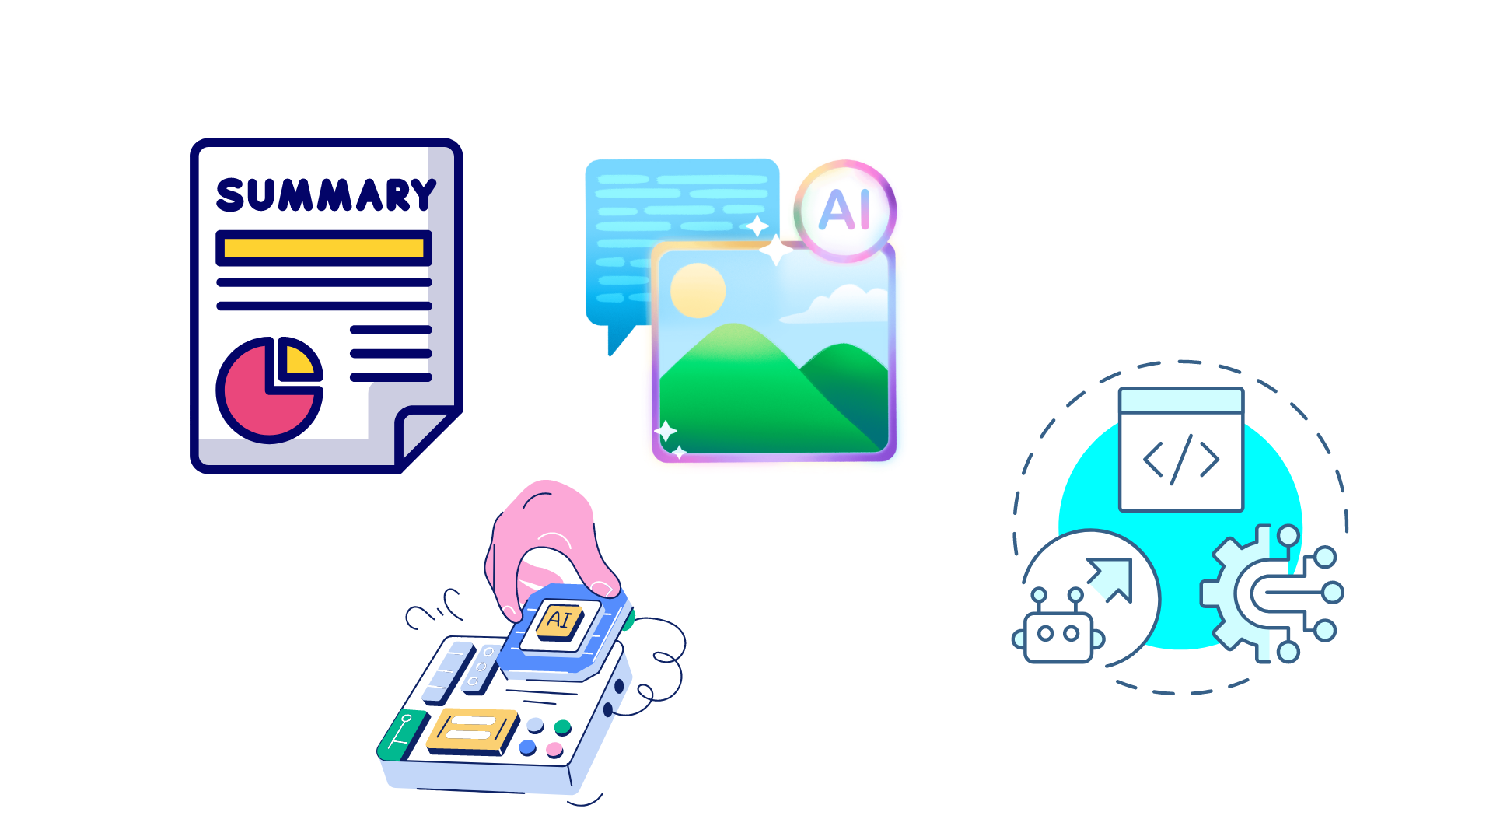
CHALLENGES ENCOUNTERED
Intelligent Content Summarization
Challenge: Developing a system that accurately summarizes diverse insurance documents while retaining critical information.
Dynamic Content Generation and Synchronization
Challenge: Creating and synchronizing AI-generated content (text, images, audio, video) coherently.
AI Model Integration Complexity
Challenge: Integrating multiple AI models (summarization, text generation, image creation) into a cohesive workflow.

Slide 14
Thank You
We eagerly await your positive response!

